Slide 1
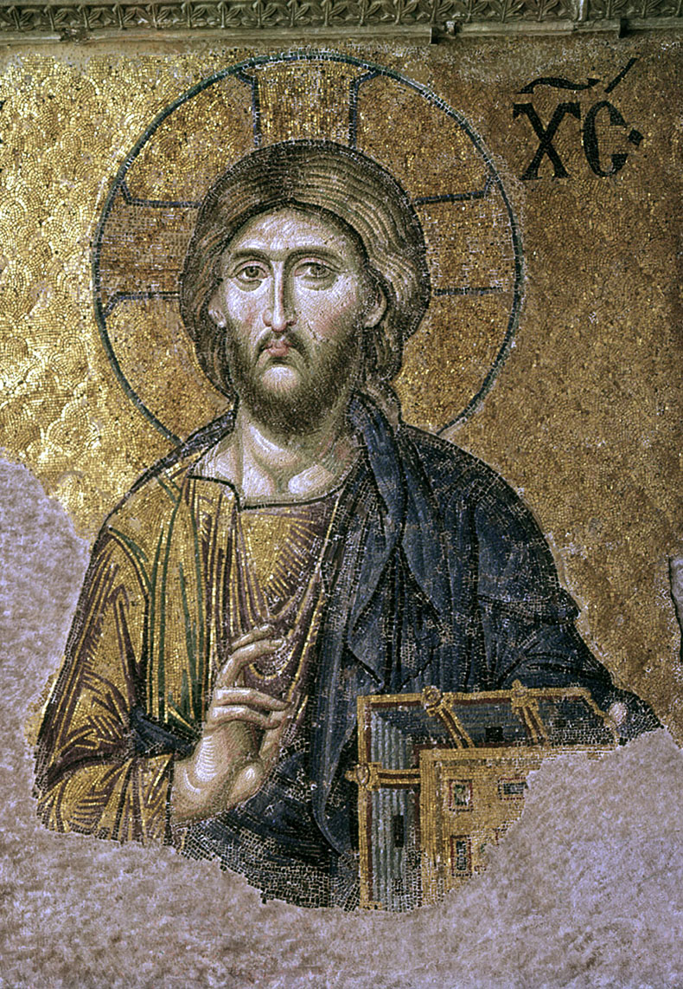
Christianity (II)

Slide 2
The Christian Bible
translation, continued
manuscript transmission
canon
Nag Hammadi & Christianity in the Second Century
discovery
contents
--------------------
Christian myth in the 2nd century
ritual in the 2nd century
after the second century

Slide 3
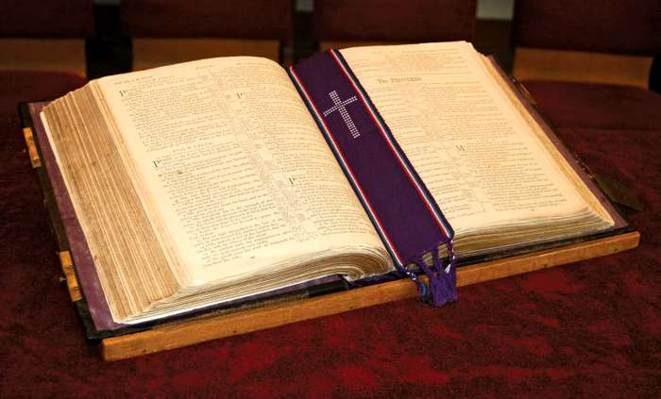
Review

Slide 4
Matthew 8:1-4 (NRSV)
“When Jesus had come down from the mountain, great crowds followed him; 2 and there was a leper who came to him and knelt before him, saying, “Lord, if you choose, you can make me clean.” 3 He stretched out his hand and touched him, saying, “I do choose. Be made clean!” Immediately his leprosy was cleansed. 4 Then Jesus said to him, “See that you say nothing to anyone; but go, show yourself to the priest, and offer the gift that Moses commanded, as a testimony to them.”

Slide 5
Matthew 8:1-4
AV (King James), 1611
NRSV, 1989
“When Jesus had come down from the mountain, great crowds followed him; 2 and there was a leper who came to him and knelt before him, saying, “Lord, if you choose, you can make me clean.” 3 He stretched out his hand and touched him, saying, “I do choose. Be made clean!” Immediately his leprosy was cleansed. 4 Then Jesus said to him, “See that you say nothing to anyone; but go, show yourself to the priest, and offer the gift that Moses commanded, as a testimony to them.”
“When he was come down from the mountain, great multitudes followed him. And, behold, there came a leper and worshipped him, saying, Lord, if thou wilt, thou canst make me clean. And Jesus put forth his hand, and touched him, saying, I will; be thou clean. And immediately his leprosy was cleansed. And Jesus saith unto him, See thou tell no man; but go thy way, shew thyself to the priest, and offer the gift that Moses commanded, for a testimony unto them.”

Slide 6
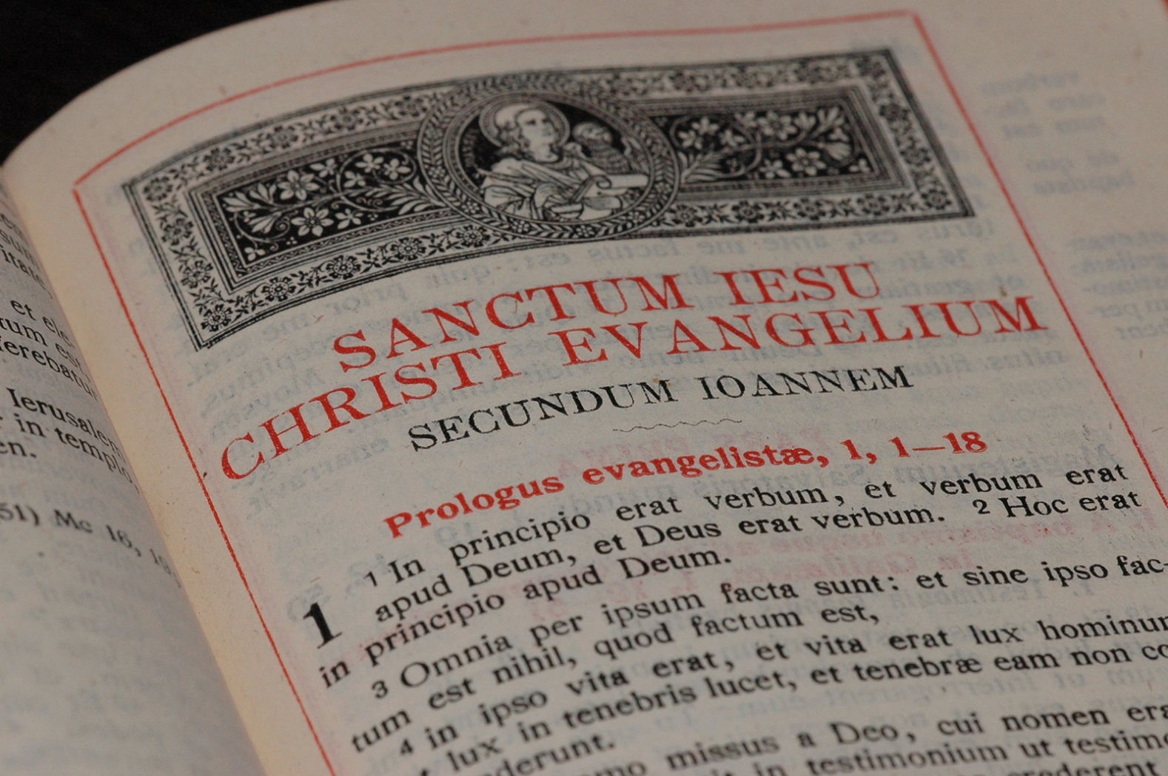
Jerome (347-420 CE): The Latin Vulgate

Slide 7
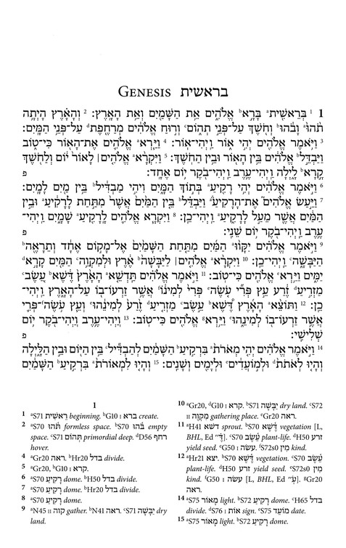
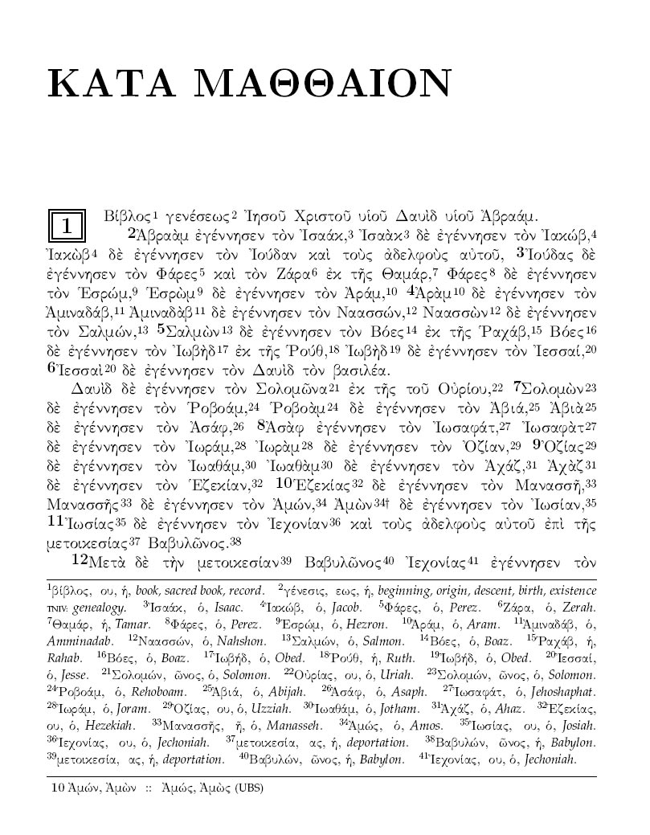

Slide 8
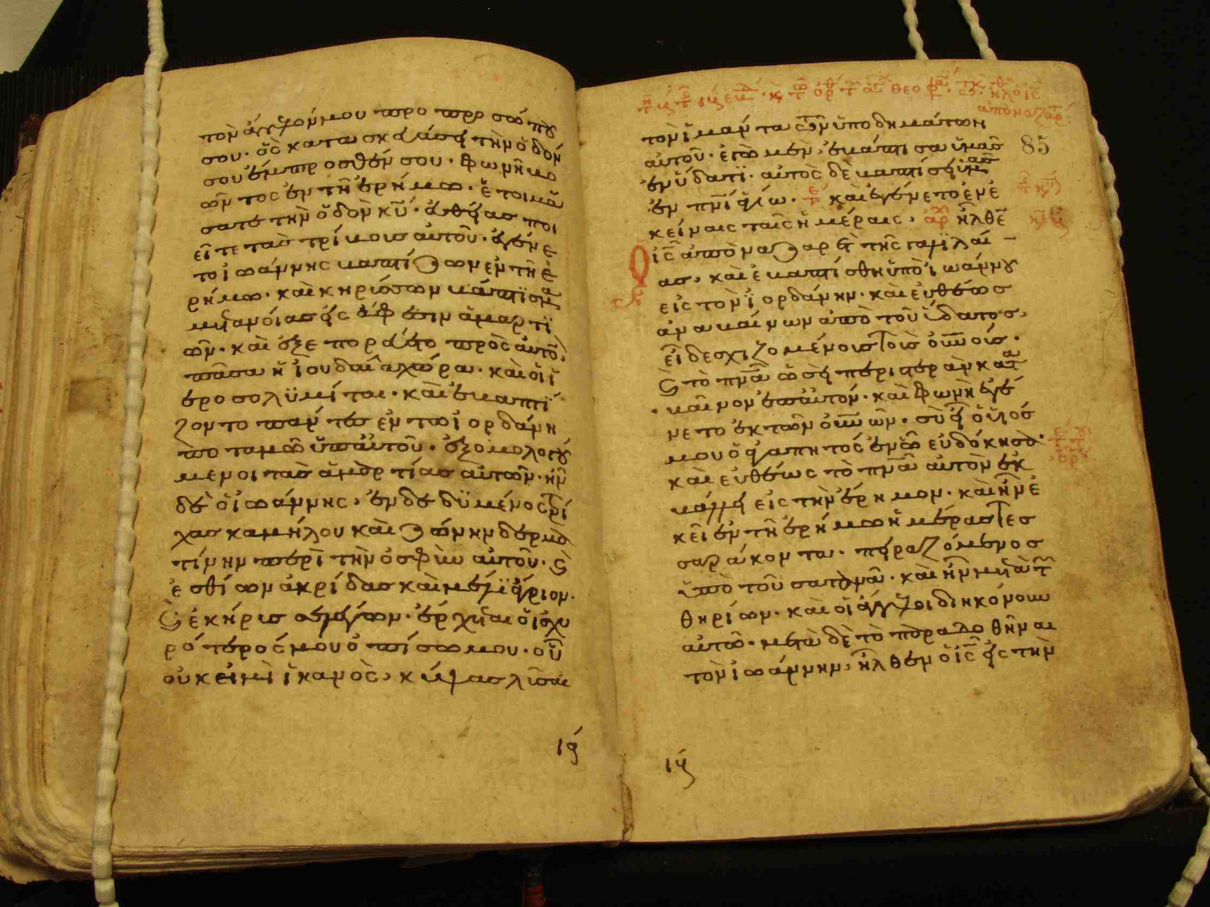
Manuscript editions

Slide 9
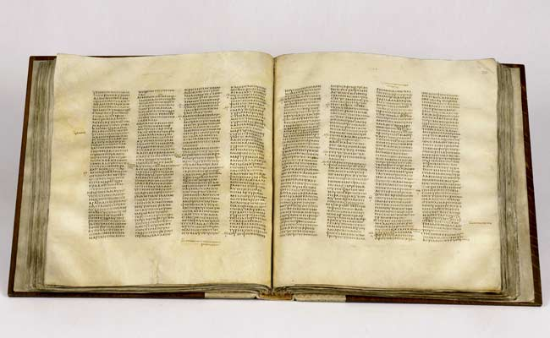
Codex Sinaiticus (330-360 CE or so)

Slide 10
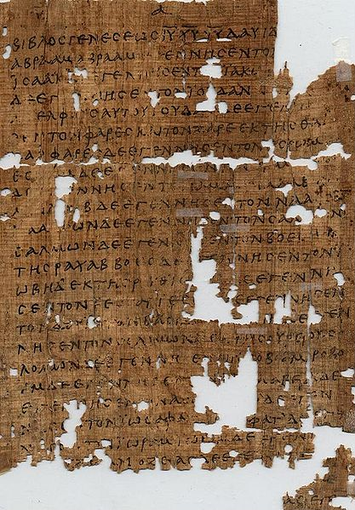
Fragmentary papyri, from about 150 CE on

Slide 11
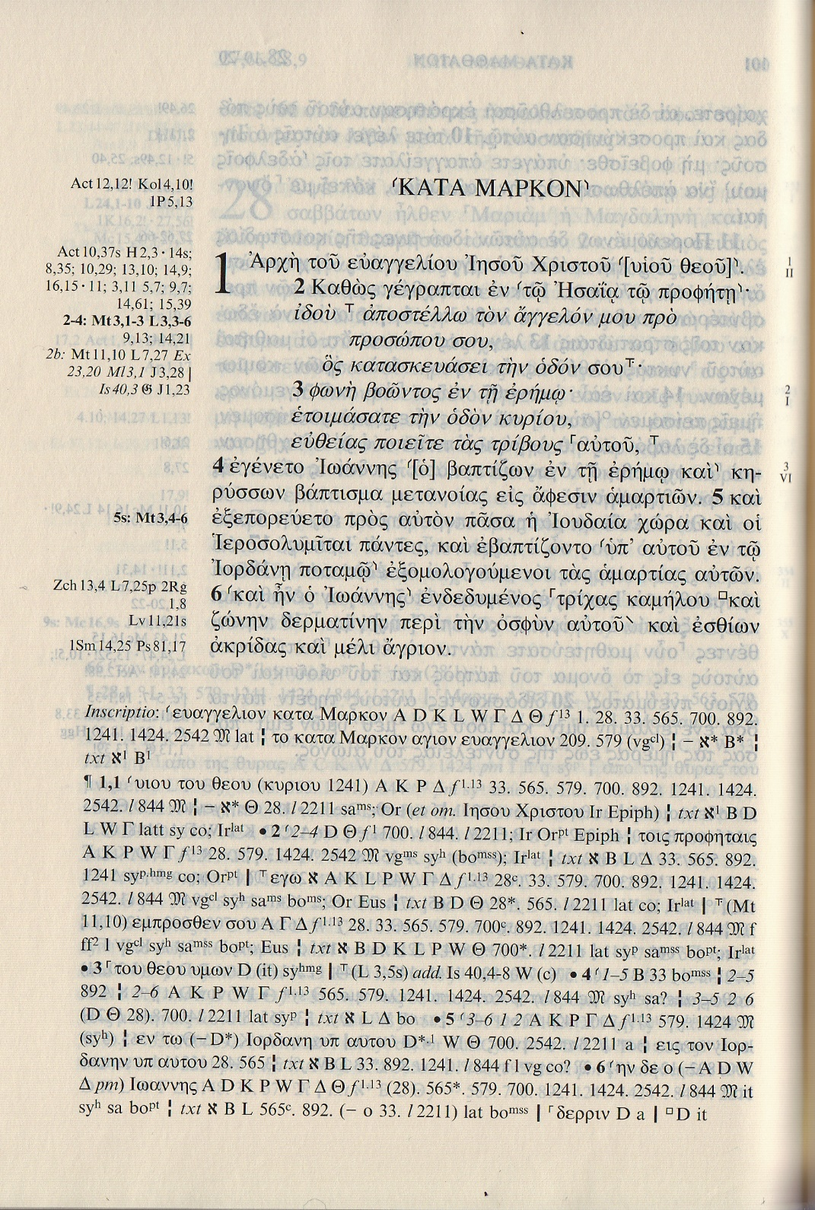

Slide 12
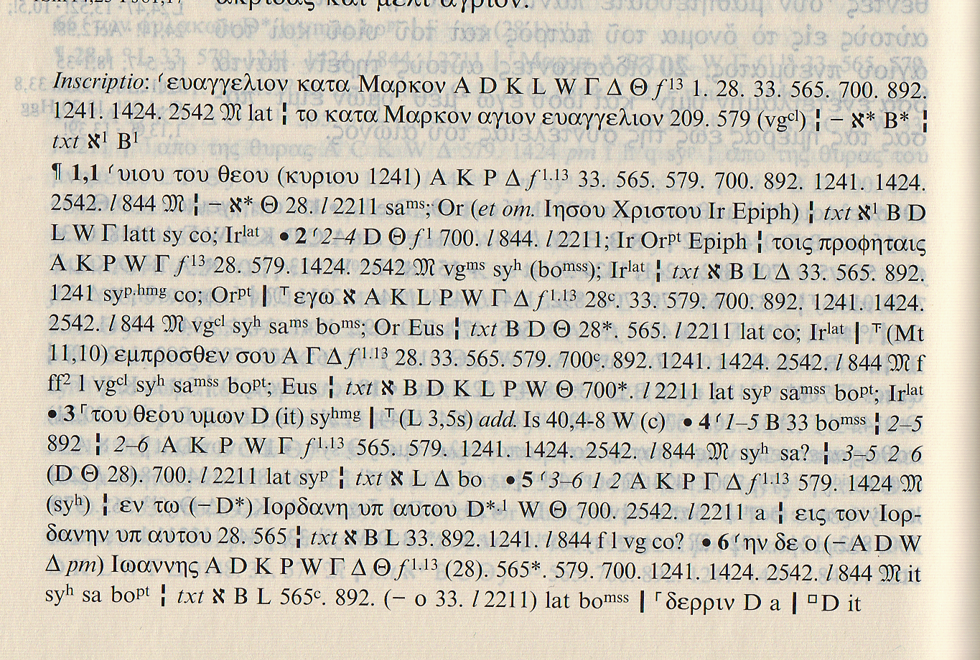

Slide 13
Contents of the New Testament (again)

Slide 14

Not everything about Jesus gets to be in the New Testament

Slide 15
Ancient Christian works not in the NT
1 Clement (a letter from one church to another)
Gospels of Thomas, Philip, Mary, Judas, etc.
Paul’s 3rd Letter to the Corinthians
Paul’s correspondence with Seneca
Acts of Peter, of John, of Thomas, of Paul, of Thekla
Infancy Gospels of James, of Thomas

Slide 16
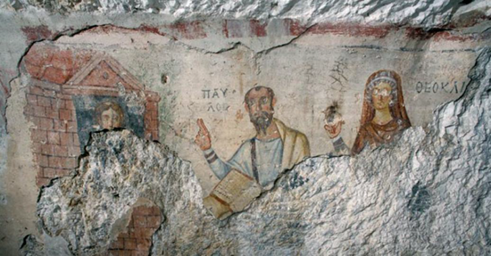
Acts of Paul and Thekla

Slide 17
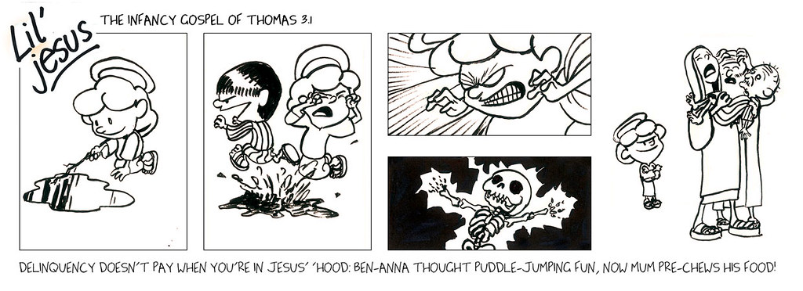
Infancy Gospel of Thomas

Slide 18
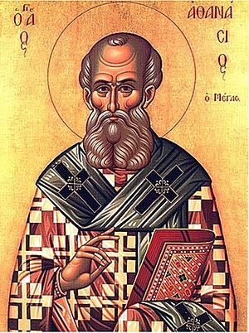
Canon & canonicity
Athanasius, 367 CE
Canonization as gradual
Consensus on useful writings
Gnosticism
Nag Hammadi (Egypt)

